Slide 1




DIGITAL LITERACY
SKILLS
INTERMEDIATE USERS

Slide 2
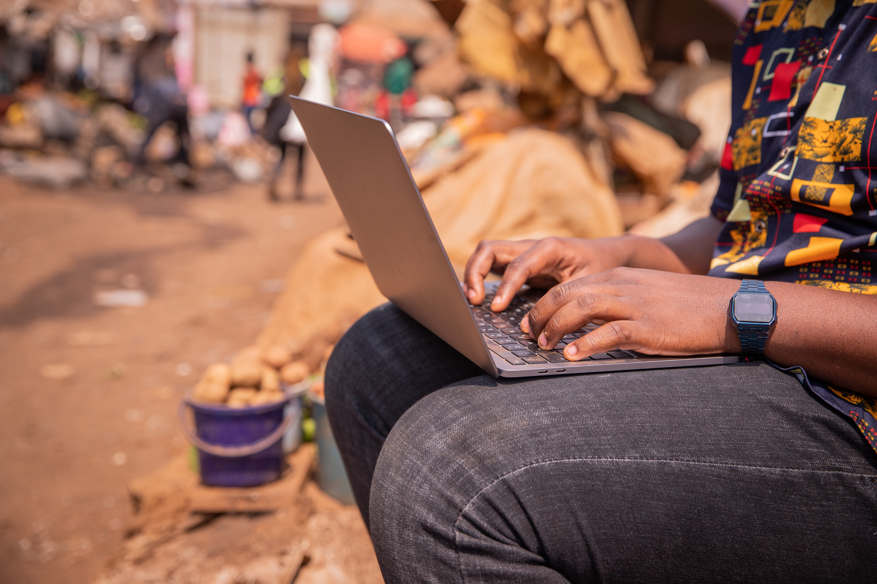
Module 3
Communication
and collaboration

Slide 3

1
Unit 1: Interacting through digital technologies

Slide 4







The process of digital communication
SENDERS AND RECEIVERS
THE MESSAGE
THE CODE
THE CHANNEL
THE MEDIUM
THE NOISE
THE ENVIRONMENT

Slide 5

Communicate with others
How to post an image on a smartphone to a Facebook page
Log into your Facebook account.
Go to the page where you want to the image to appear.
Click on the Photos button to access the smartphone’s gallery.
Select the picture you want to add.
Continue >

Slide 6
Communicate with others
Choose Share external from the drop-down menu at the top of the screen.
Click on Facebook’s News Feed button.
Once the image appears on the page, add text or a caption explaining the image.
Click the Post button, then select which people should be able to view the image.

Slide 7
Communicate with others
Follow these steps to post a thread on Twitter
Click on the tweet button to create a new tweet
If you want to add another tweet, select the plus icon.
If you want to delete any of the tweets, choose the delete button.
Once you are done adding all the tweets you want in the thread, select Tweet all to post them.

Slide 8

Secure digital communication
The term ‘security’ is used in data sharing and digital communications.
This refers to:
the threats that can cause information to be lost, stolen or corrupted (made unusable)
access to information over a network by an unauthorized user who might steal or tamper with the information.

Slide 9
Secure digital communication
Secure information is hidden from the public so that no unauthorized user can find it.
Security in digital communication means keeping information hidden (private) when it is being transferred across a network (usually the internet) to another user or system.

Slide 10

Social media
Ways to communicate with others using social media:
Download and install WhatsApp or Telegram on a smartphone or tablet, then practise sending messages and images.
Record and send a voice note and attach a file.
Create a Gmail account you do not already have one.
Continue >

Slide 11
Social media
Store, share and collaborate on files in Google® Workspace.
Do a video call using free services, such as Zoom or Skype.
Build a simple blog, using images downloaded from the internet.

Slide 12
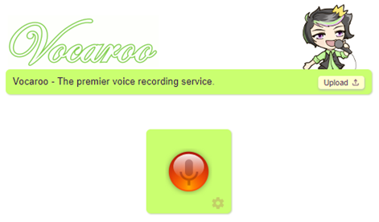

Skills to practice
Send a voice note and share a file.
Open the WhatsApp app on a tablet or smart phone. Send a voice message to a friend where you explain your Mathematics homework for tomorrow.
Open the Vocaroo website (https://vocaroo.com/ )
Prepare a three-minute lesson on how to complete your Mathematics homework correctly. Click on the microphone to start recording the message.
Continue >

Slide 13
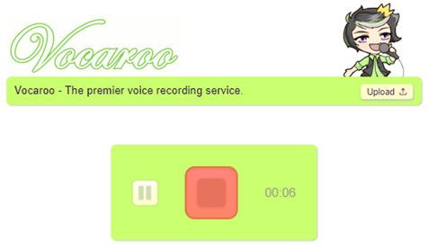
Skills to practice
When you have finished recoding the message, click on the red square
Continue >

Slide 14
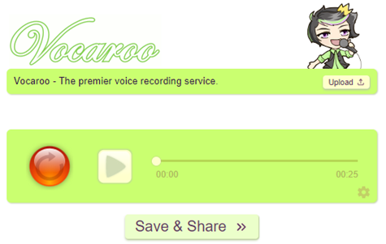
Skills to practice
Click on ‘Save & Share’.
Continue >

Slide 15
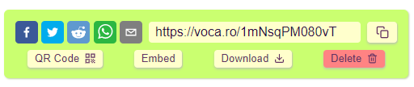
Skills to practice
You can now:
delete the file if you don’t like the recording and start again
download the file as a MP3 file to your device
embed the recording in another file – like a PowerPoint presentation
create a QR code for the file and share the code with a friend who can listen to the recording
post (share) your recording on social media as a MP3 file.

Slide 16
All back covers should include
contact information of the section
producing the work.
© United Nations Children’s Fund (UNICEF) [month and year of publication]

